Slide 1
Advanced Database Topics
Instructor:
Dr.stephanos Mavromoustako
03-60-615

Slide 2
Tableau
Prepared By: -
Mitanshi Patel - 104892554
Jagruti Patel - 104908316
Hiral Patel - 104711509

Slide 3
Introduction
Tableau is one of the fastest evolving Business intelligence and data visualization tool. It is very quick to deploy, easy to learn and very spontaneous to use for a customer. It has evolved into one of the fastest and easiest.

Slide 4
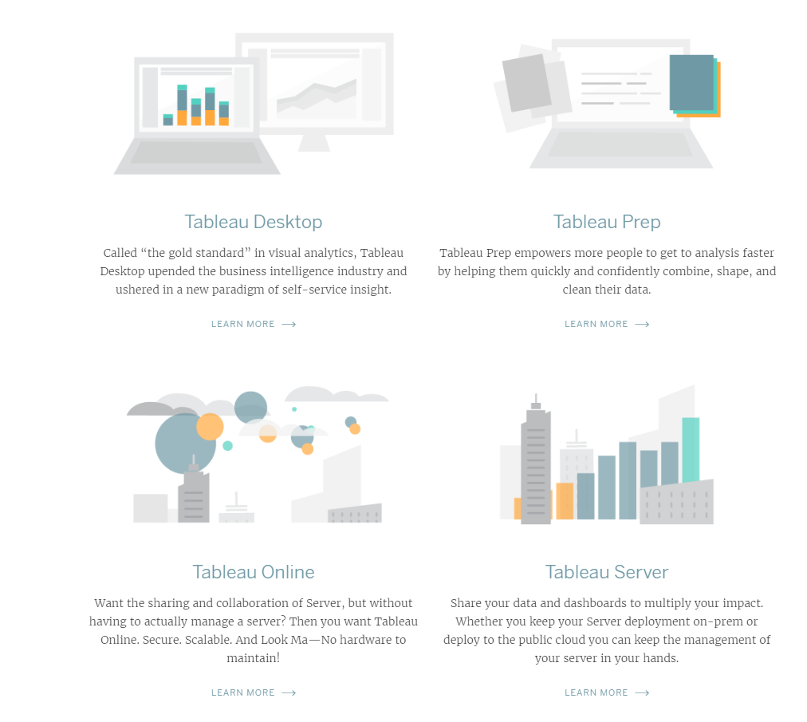
Products of Tableau

Slide 5
Data Visualization
Data Visualization is the process of describing information through visual rendering
Importance of data visualization
Technological advances have made data visualization more
prevalent and powerful than ever before.
Businesses purpose.

Slide 6
Let’s connect Tableau to the data!
Connecting to data
Excel Database Cloud

Slide 7
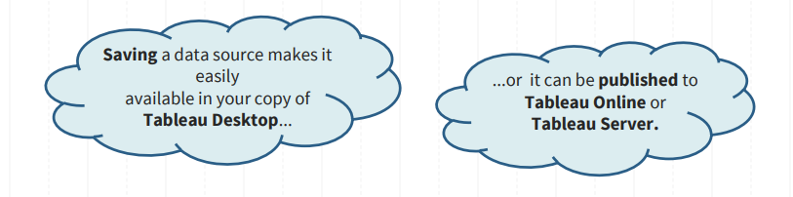
Saving And Publishing Data Sources
Saving data source as a .tds -> this is not the data itself!

Slide 8
Total File Types
Workbook (.twb): Workbooks hold worksheets, dashboards and stories.
Bookmark (.tbm): Bookmarks contain a single sheet.
Packaged workbook (.twbx): Archive containing a workbook along with all data sources and files.
Data extract (.tde): Local copy of a subset or entire data source to share and improve the performance.
Data source(.tds): Shortcut to oftenly used data sources, containing information and modifications.
Packaged data source (.tdsx): Archive containing a data source file along with any related files.

Slide 9
Data Joining And Data Blending
When to use joining:
You can only use joining when your data comes form the same underlying source (for example, the same Excel file or Access file).
When to use data blending:
It’s not same as Data Joining, Data Blending in tableau allows combining of data from different sources and platforms.
For Example, you can blend data present in an flat file (csv) with Teradata or DB2 databases DB to create a combined / blended dataset.

Slide 10
Difference Between Joining And Blending Data:
Joining term is used when you are combining data from the same source, for example, worksheet in an Excel file or tables in Oracle database while blending requires two completely defined data sources in your report.

Slide 11
Cross-database Join
You can't always answer your questions with a single data set. Sometimes, to answer your hardest questions, you have to integrate multiple data sets to uncover insight.
This is a new feature in Tableau 10

Slide 12
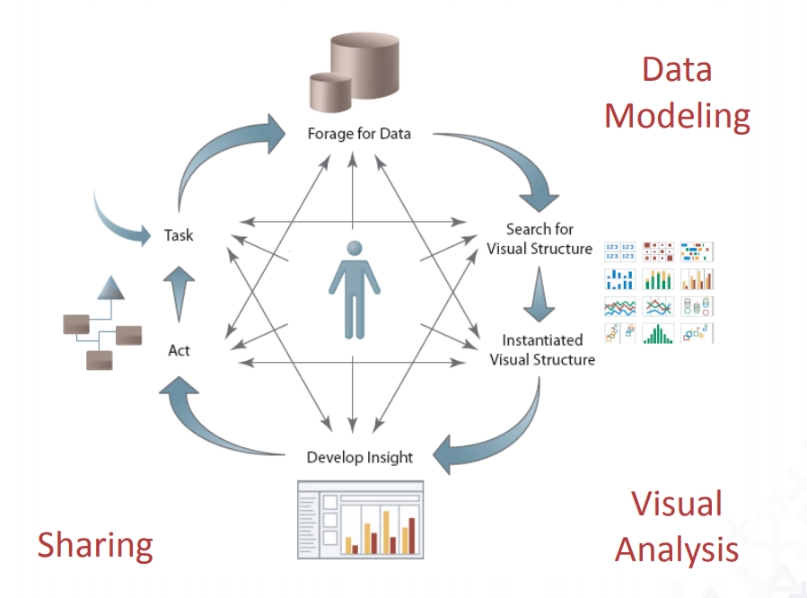
Cycle Of Visual Analysis
An unpredictable and cyclical process of question-and-answer involving many tasks:
• Discovering structure
• Finding patterns and outliers
• Deriving causal relationships
• etc.

Slide 13
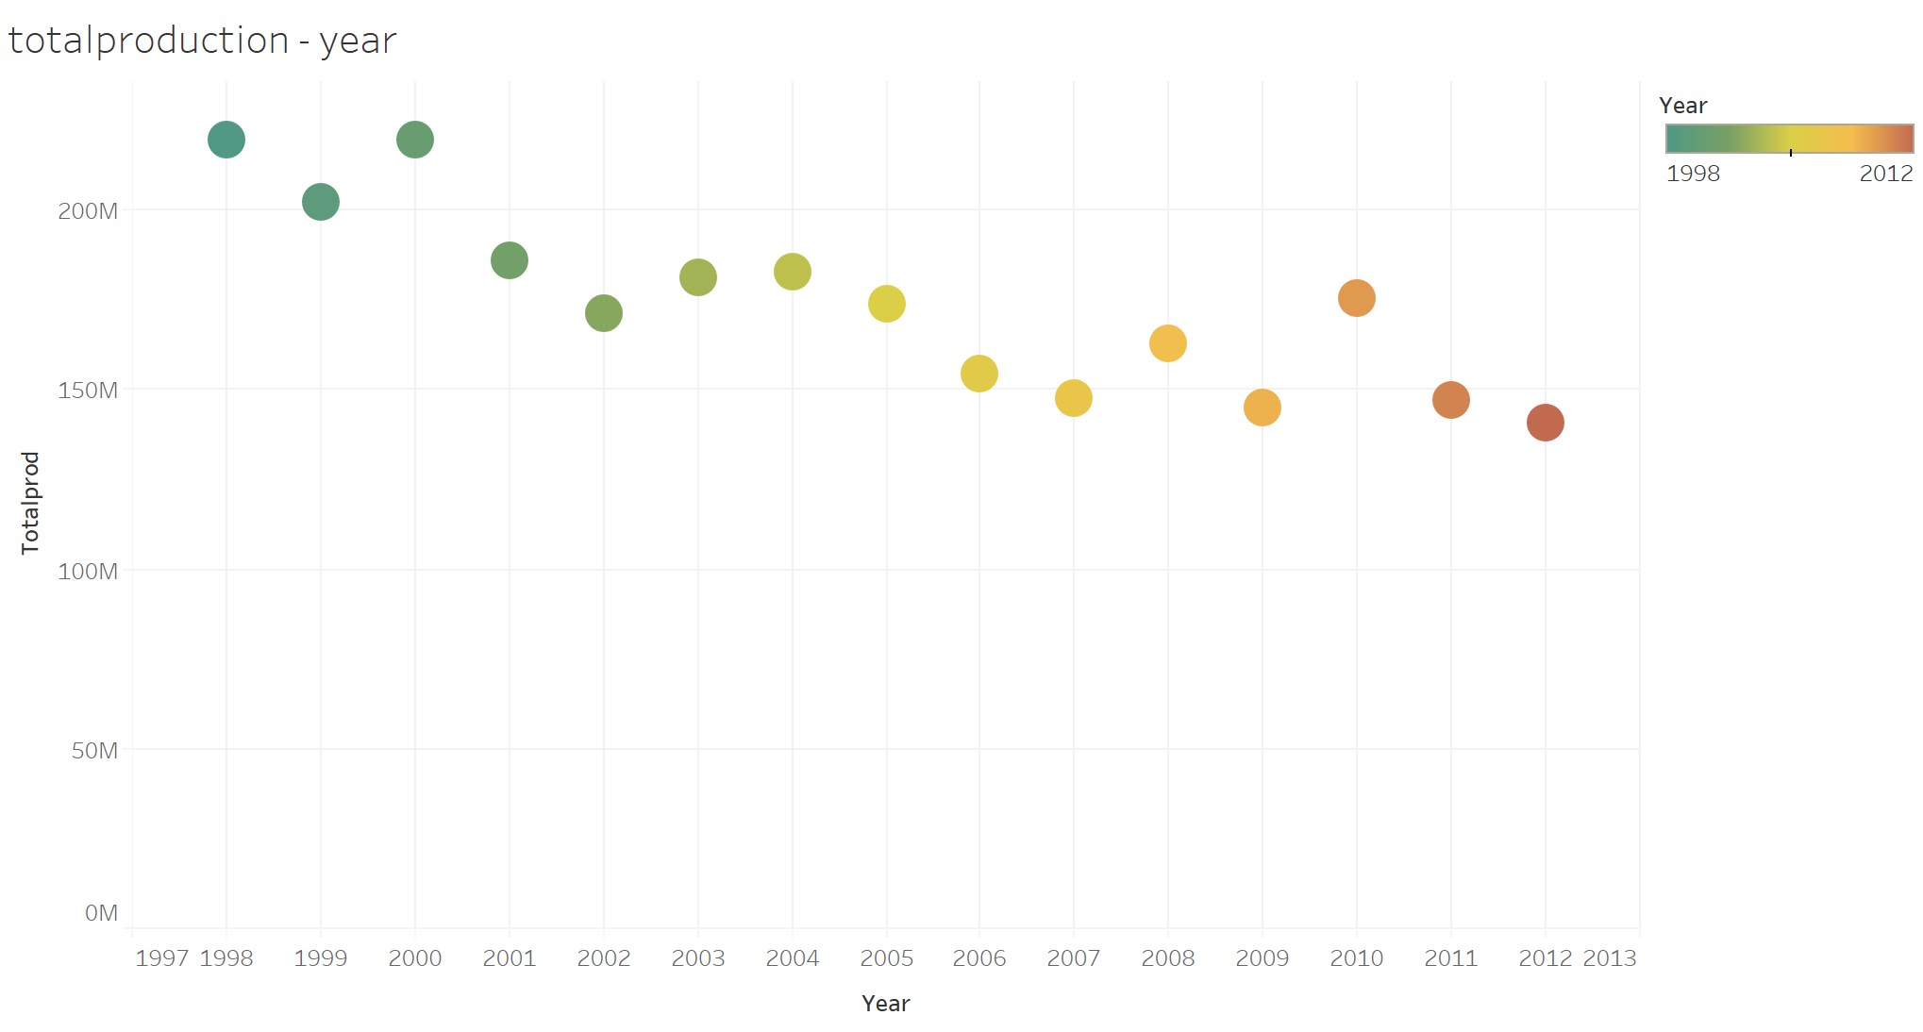

Slide 14
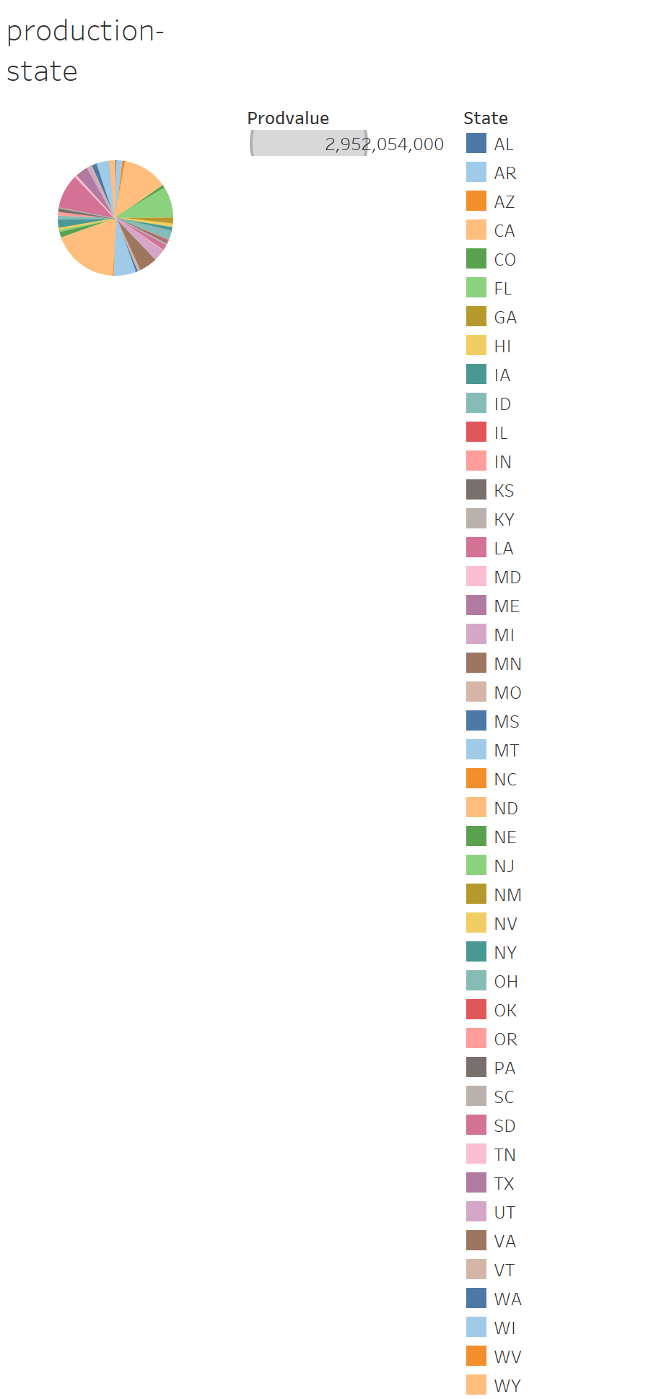

Slide 15
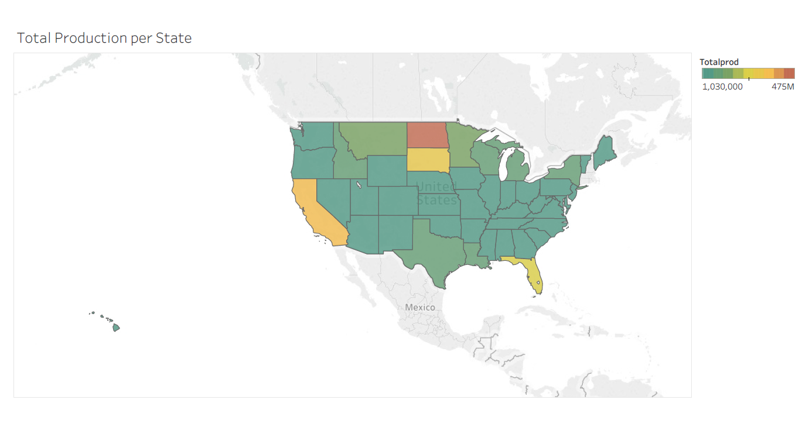

Slide 16
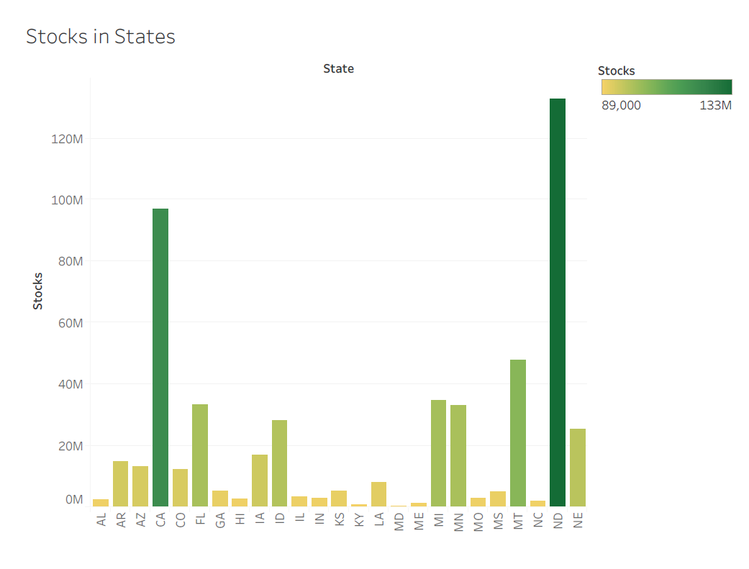

Slide 17
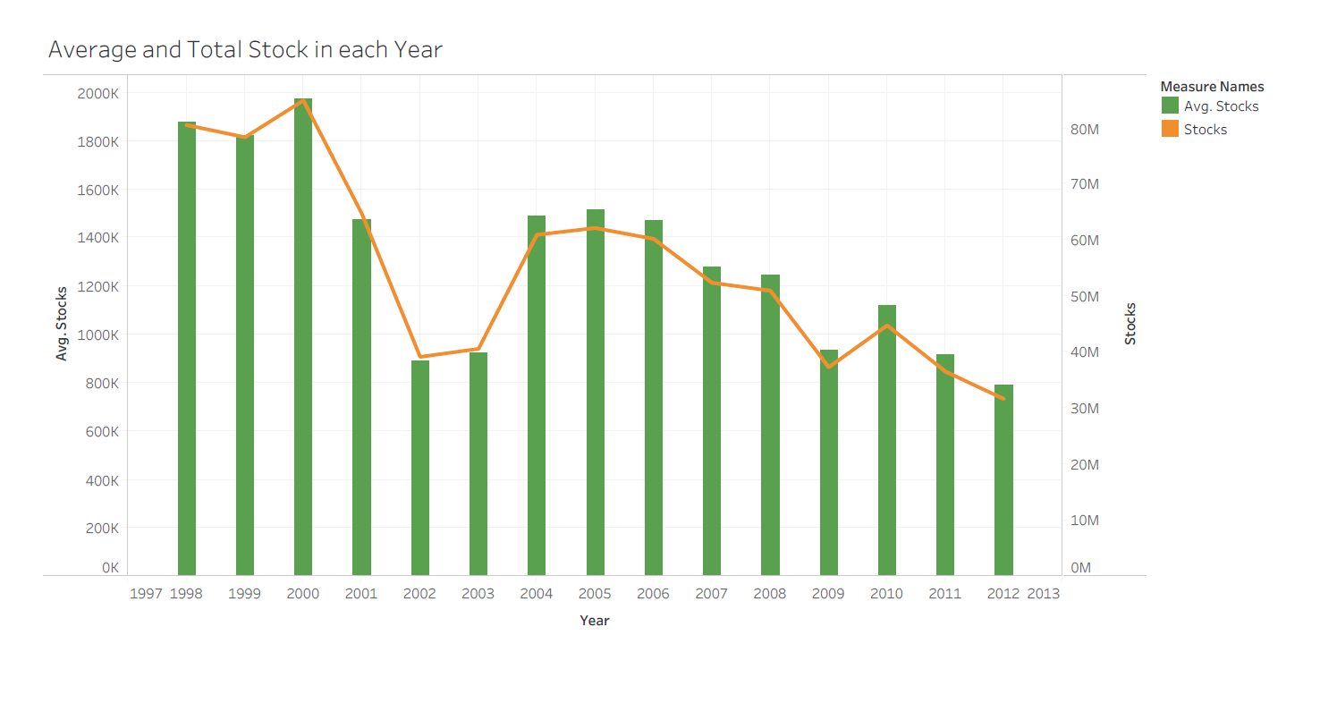

Slide 18
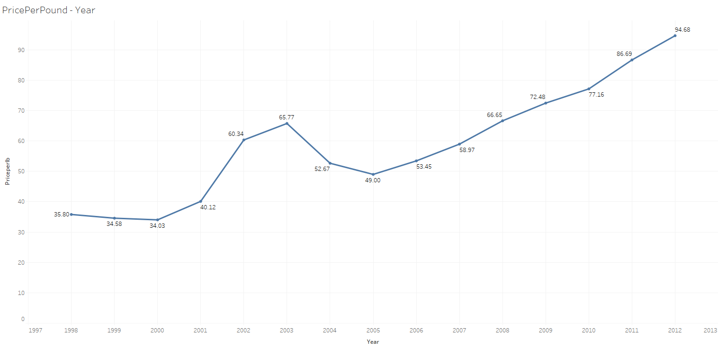

Slide 19
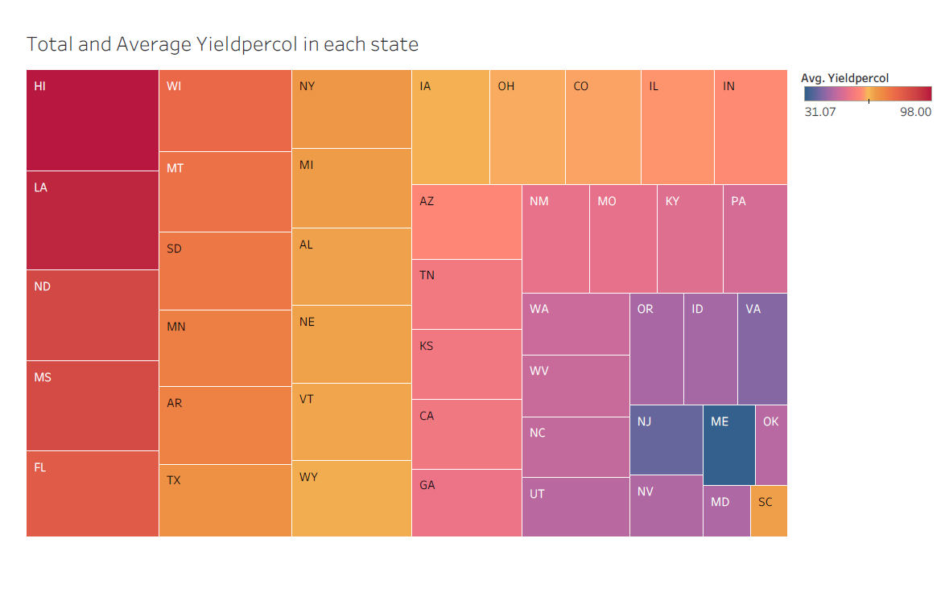

Slide 20
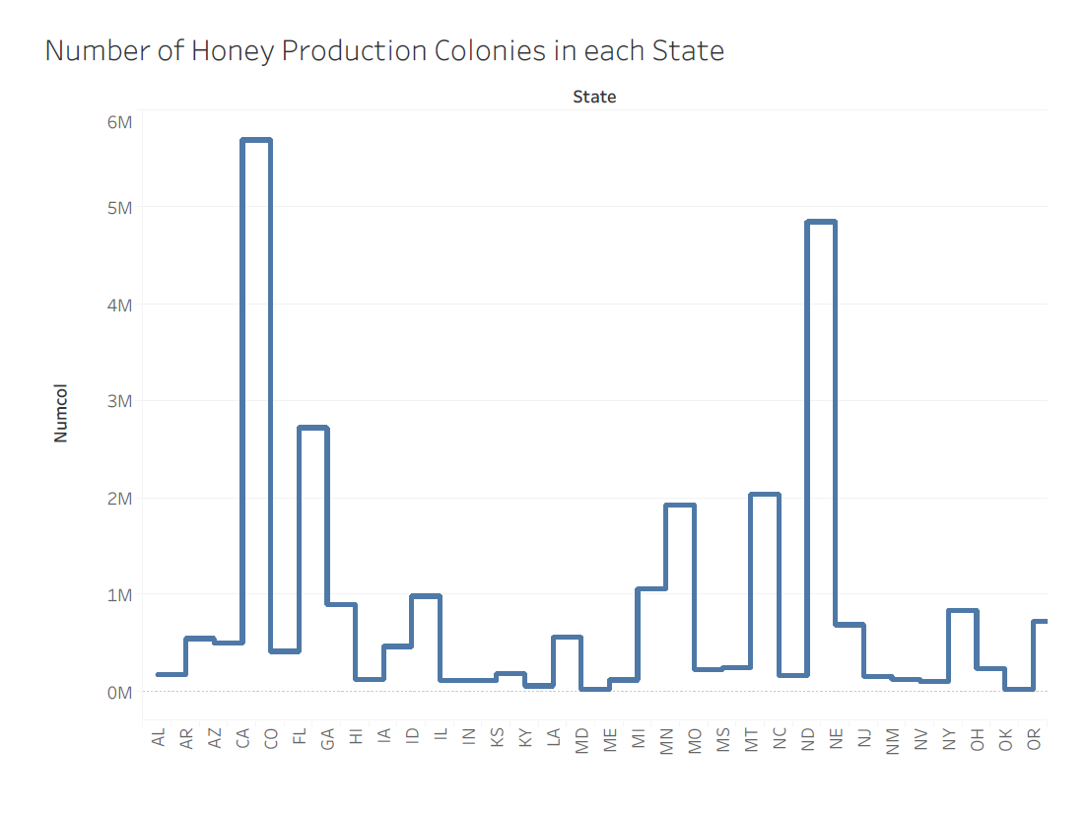

Slide 21
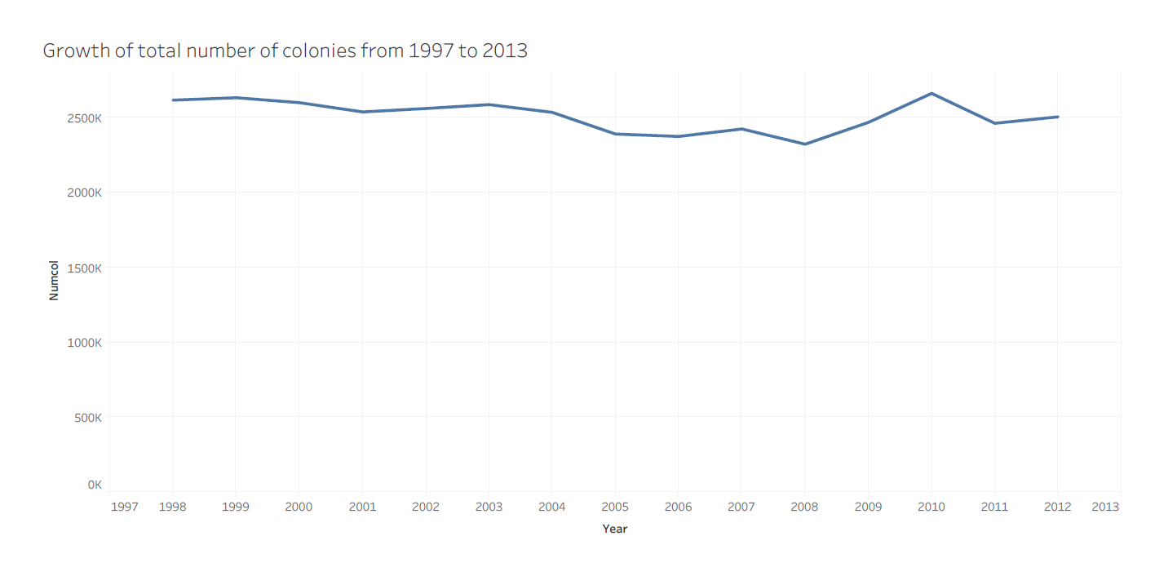

Slide 22
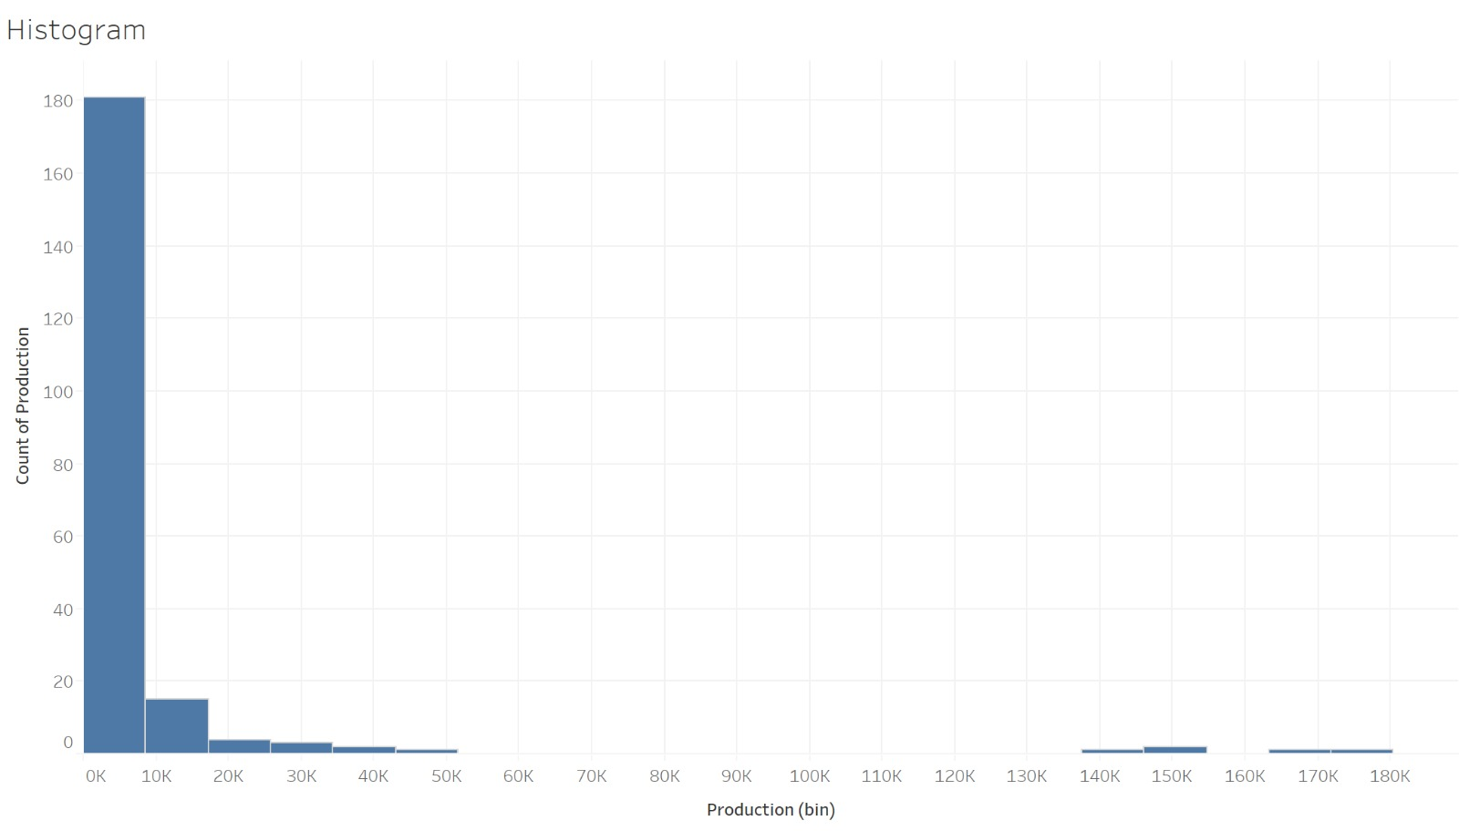

Slide 23
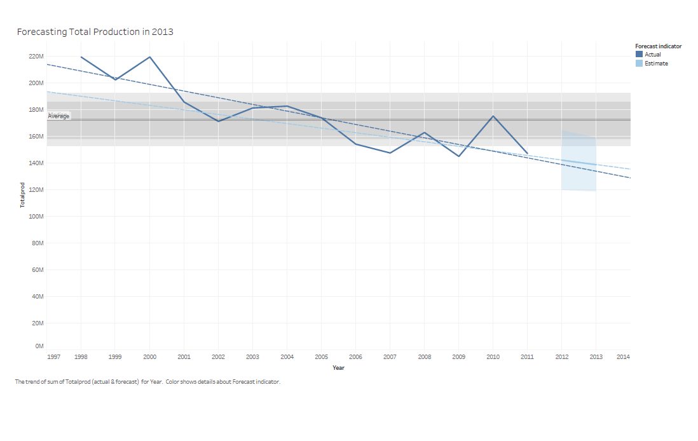

Slide 24
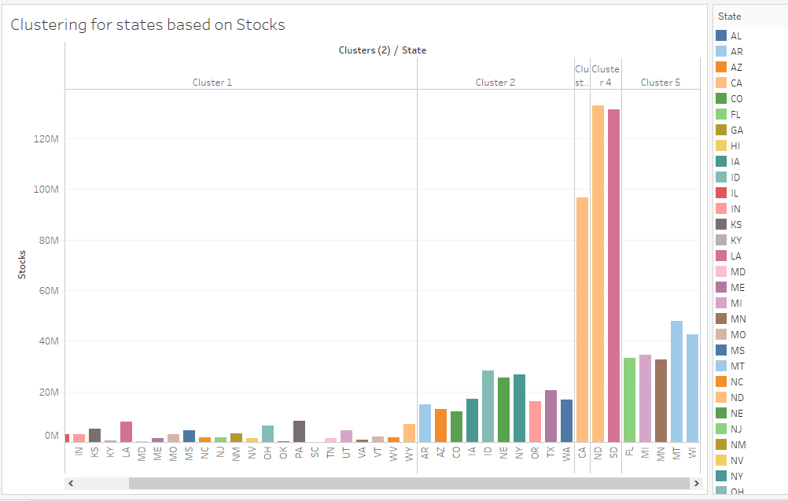

Slide 25
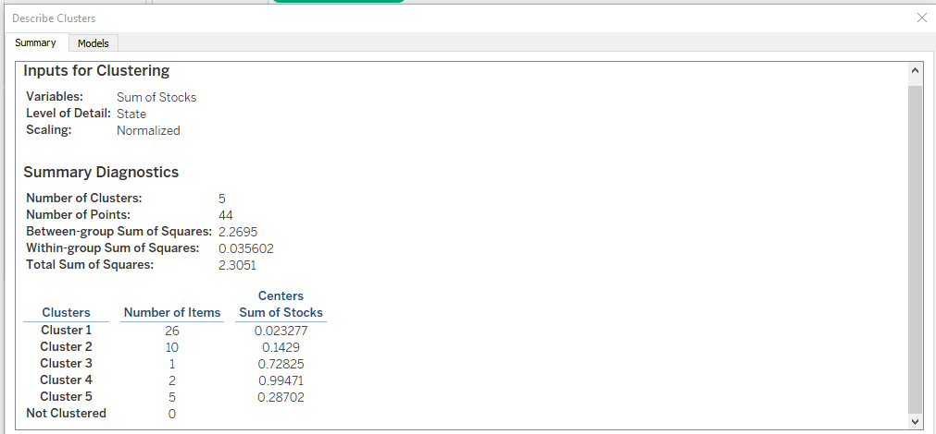

Slide 26
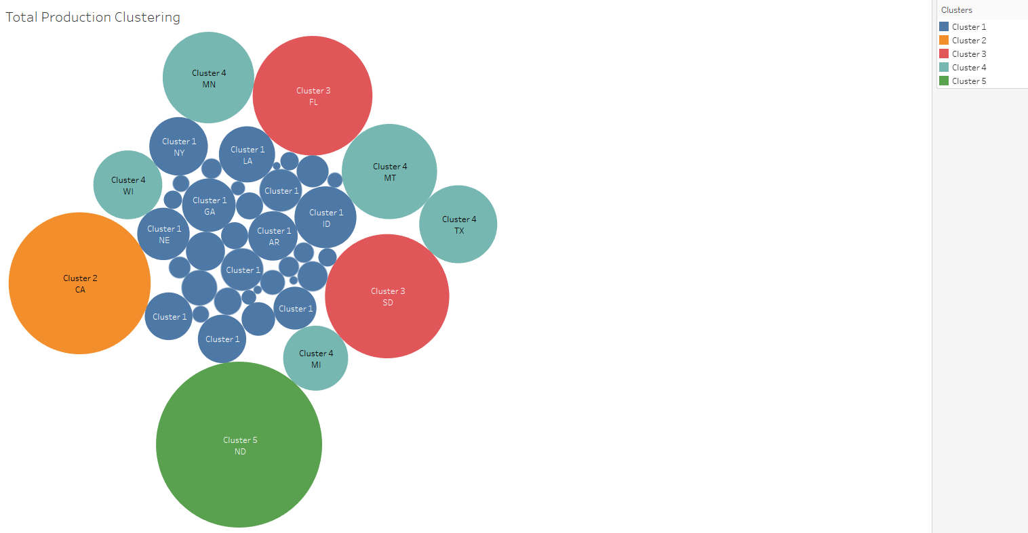

Slide 27
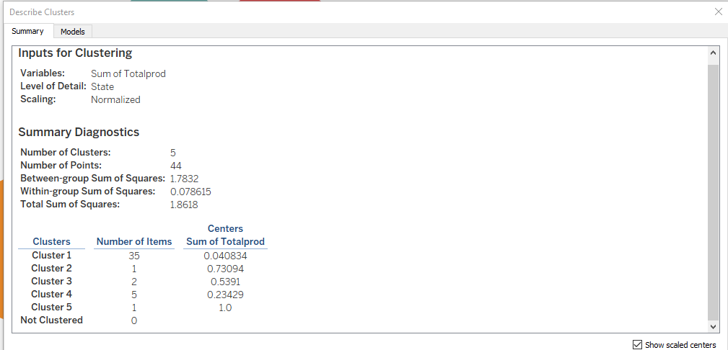

Slide 28
What Has To Offer Tableau Online?
◉ Skip hardware cost & setup time
◉ Connection with other users
◉ Support live data connections
◉ Secure

Slide 29
References
https://www.tableau.com/products
https://www.slideshare.net/AndreaBissoli/tableau-presentation-70031000?from_action=save
https://www.slideshare.net/seethaBTS/tableau-ppt
https://www.tableau.com/about/blog/2016/7/integrate-your-data-cross-database-joins-56724
https://community.tableau.com/thread/195684

